Slide 1
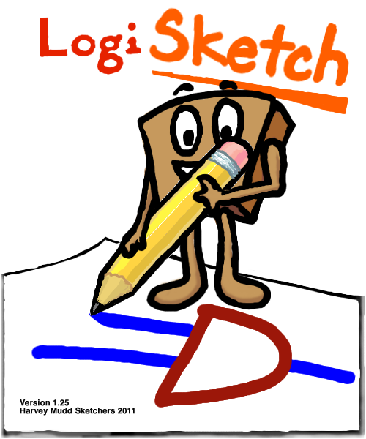
LogiSketch
Fiona Foo,
Alexa Keizur,
Andy Kearney,
Calvin Loncaric,
Miranda Parker,
Jessi Peck,
Kiley Sobel
An Intuitive System for Sketching and Simulating Logic Circuits
Prof. Christine Alvarado
Notes:
Introduce everyone and then present video

Slide 2
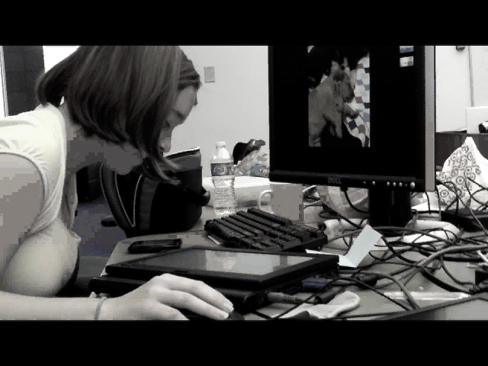

Slide 3
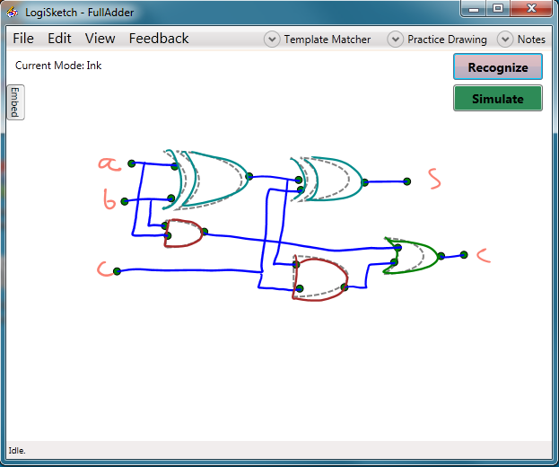
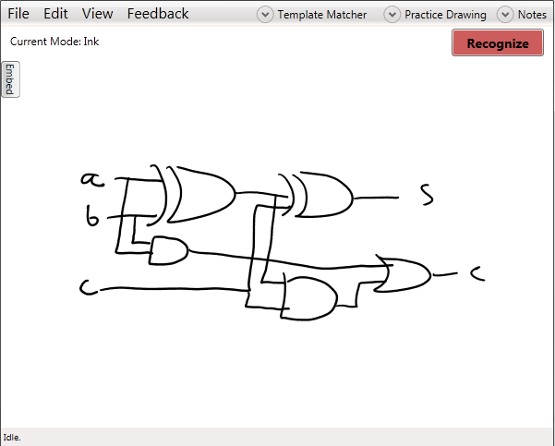
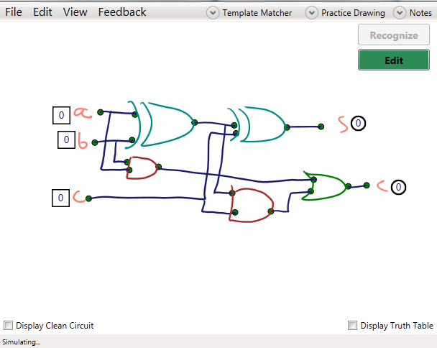
LogiSketch
An intuitive system for sketching, editing, recognizing, and simulating logic circuits in a tablet environment

Slide 4
Recognition
Transforming your sketches into reality

Slide 5
Recognition: Five Steps
Stroke Classification
Stroke Grouping
Shape Recognition
Shape Connection
Shape Refinement

Slide 6
Shape Recognition
How did it work before?
Why did we change it?
Notes:
Combo Recognizer – combined the results from four separate sub-classifiers using a Bayes net
Waaaaay too complicated. Users had no idea what was happening to recognize their sketches and it was too complicated to efficiently debug, so there were many problems with it. We wanted to create a recognition method that the user could follow and that would be easy to maintain.

Slide 7
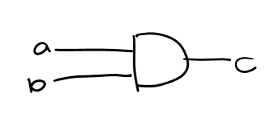



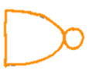
Adaptive Image Recognition
To improve recognition accuracy, we created an adaptive image-based recognizer to classify logic gates.
And?
Not Bubble?
Nand?
Or?
Notes:
We created AIR. Matches your drawing against templates to attempt to assign the correct gate-label to your shape.

Slide 8
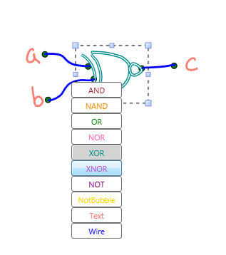
Recognizer Learns from its Mistakes
Notes:
When the system incorrectly recognizes a gate, the user can correct that error. The AIR will then adapt to the error correction and will hopefully never make the same mistake again!
Users have distinct drawing styles, and the general recognizer tries to recognize everything. However, if just one user is working with the system on a particular computer, we can adapt the recognition to their particular drawing style.
When a user corrects an error, we add the template to the image recognizer, so the next time it sees a similar looking gate, it will recognize it correctly.

Slide 9
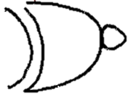

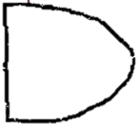
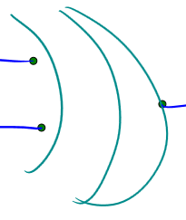
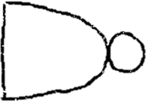
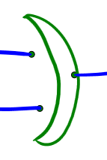
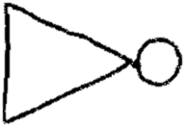
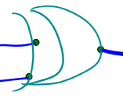

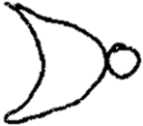
Template “Phase-Out”
Notes:
BETTER PICTURE – maybe pics of our templates?
Maintain efficiency
Improve accuracy
Eliminate bad templates
We also “phase-out” templates that caused past incorrect recognitions. Limiting the number of templates helps us maintain the efficiency of the software.
Keep track of the “usefulness” of each template to see which ones to remove.
Say you’re feeling lazy one day and you draw a couple of sloppy gates. These may get introduced as templates if you relabel them. But these may lead to recognition errors, so you don’t want them to stick around forever. So we get rid of the ones that lead to unhelpful results.

Slide 10
User Adaption Improves Recognition
Notes:
Initial tests show that the recognizer quickly gets significantly better when learning from its mistakes

Slide 11
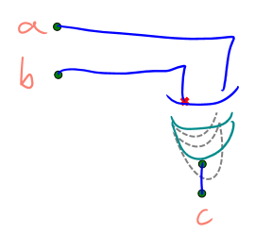
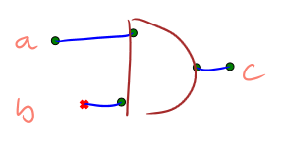
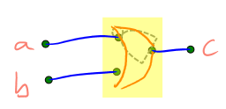
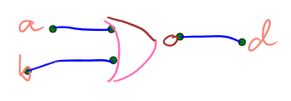
Nobody’s Perfect
Classification
Problems
Connection Problems
Grouping Problems
Recognition Problems

Slide 12
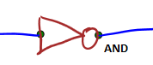
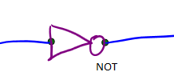


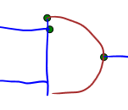
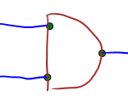
Shape Refinement
Re-identify shapes
Form/break connections
Steal/shed strokes

Slide 13
Avoid chaos: Use an energy function!
Avoid wasting your users’ time: Use intelligent assumptions!

Slide 14
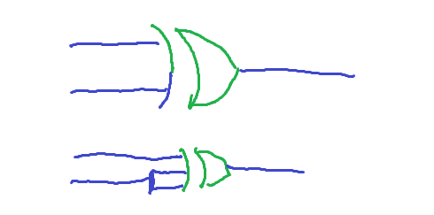
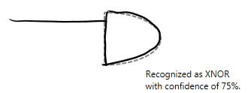
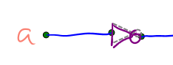
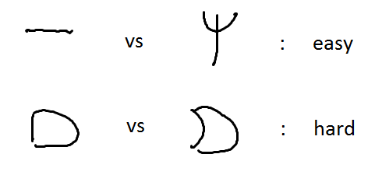
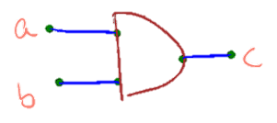
Limitations
90%
91.346%
?

Slide 15
Obviously incorrect recognitions often have a correct interpretation
90%
91.346%
?

Slide 16
Confidences are unreasonably high on previously unseen shapes
90%
91.346%
?

Slide 17
Different specialized recognizers give incomparable measurements
90%
91.346%
90%
91.346%
?

Slide 18
Similarities between gates
90%
91.346%
?

Slide 19
Identical Contexts
90%
91.346%
?
?

Slide 20
Results

Slide 21
User Interface
Improving the user experience

Slide 22
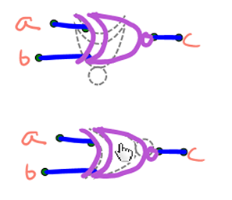
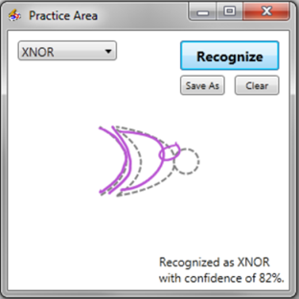
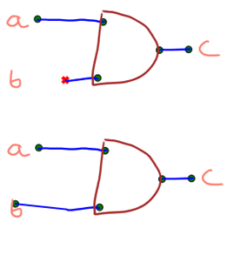
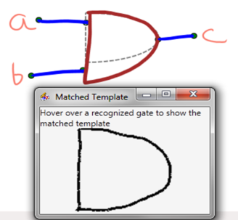
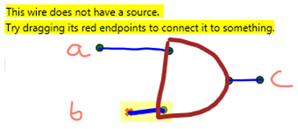
Initial User Study
What problems are users having?
Communicating errors with the user
Exposing the recognizer
How can we fix them?

Slide 23
Orientation was a problem. We now let you manually set the orientation.

Slide 24
Parsing errors were hidden from the user. All parsing errors now are highlighted with descriptions

Slide 25
Connections were a problem. We now let you manually extend wires, creating connections permanently

Slide 26

The recognizer’s behavior was hidden from the user. Now the templates matched to the strokes are viewable.

Slide 27

Users had no way of trying to explicitly interacting with the recognizer. Now the user can practice gates.

Slide 28
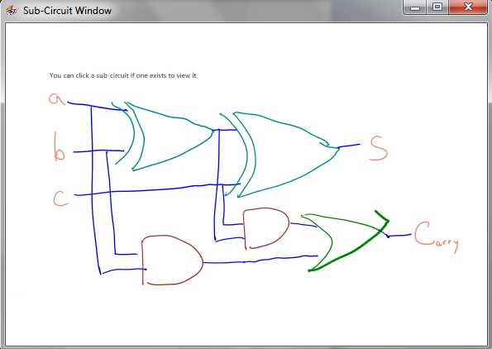
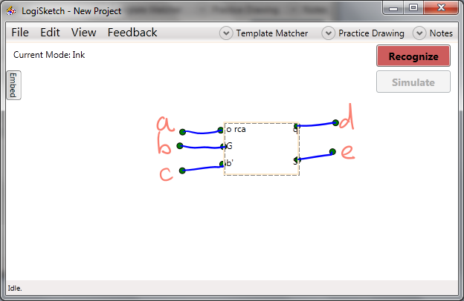
Creating complex circuits
Notes:
Allow users to create more complex circuits
Compatible with LogiSim

Slide 29
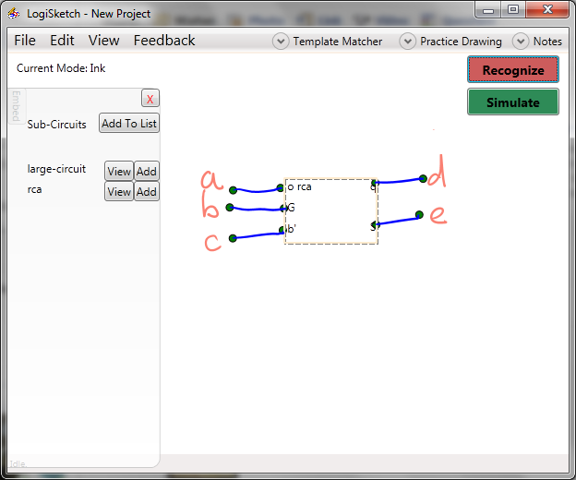
Notes:
Allow users to create more complex circuits
Compatible with LogiSim

Slide 30
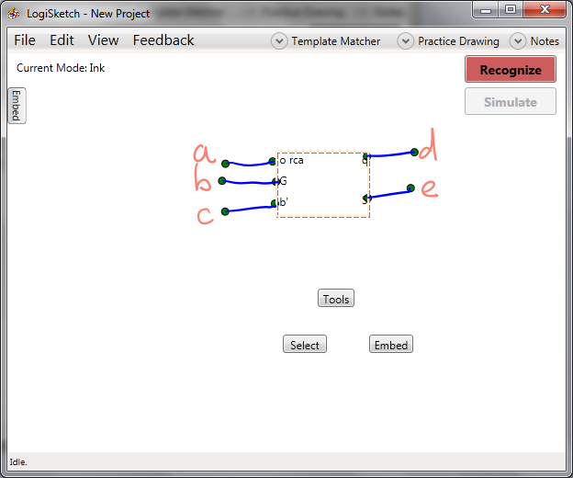
Notes:
Allow users to create more complex circuits
Compatible with LogiSim

Slide 31
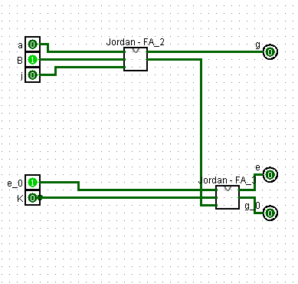
Compatibility with other tools
Notes:
Allow users to create more complex circuits
Compatible with LogiSim

Slide 32
Future Work
Investigate user responses to moving and rotating UIs
Develop more precise tools for correcting grouping vs recognition errors

Slide 33
User Study
Exploring drawing style adaption

Slide 34
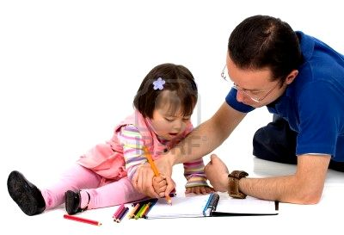
Background
There is a relationship between how sketches are drawn and how much work recognition has to do.
Could the system sway users to inadvertently draw in a certain way so recognition wouldn’t have to work as hard?
No, no! A NOR looks like this!
Notes:
Draw closer to the recognizers ideals
If the user adapts, the recognizers don’t have to be as good
Trade off between programmer time and the time it takes the system to run vs. the improvement of the users’ drawing style (less of the user’s and system’s time)

Slide 35
Research Question & Hypothesis
Will users adapt their drawing styles to improve recognition when given certain feedback from the system?
Hypothesis: Users drawing with specific feedback that tells them how their drawing can improve will make more positive drawing style changes, compared to users drawing without that feedback.

Slide 36
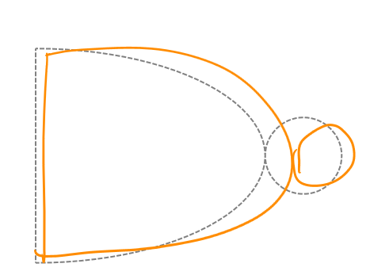
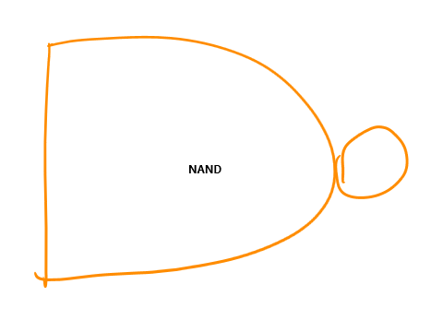
Procedure
Condition 1: Ghost Gates
Condition 2: No Ghost Gates
12 users
Each user draws and corrects 14 circuits
Notes:
In both cases, they get recognition feedback (told what everything is).
For the ghost gate condition, they also received drawing feedback, what they could do to make their drawing better.

Slide 37
Results
Pictures of users’ sketches over time
Measurement: correct recognition rate (the percent of the total gates that were recognized correctly by the system) for each sketch.
Notes:
Here are a couple of examples of users’ sketches…..

Slide 38
Results

Slide 39
Good News
Interview question
User 12: “This is so much better than LogiSim.”
User 16: "I appreciate that much more than LogiSim"
User 3: “It's more fun than what we do currently in CS5.”
User 17: “This is kind of fun.”

Slide 40
Future Work

Slide 41

Acknowledgements
We’d like to thank our research advisor, Professor Christine Alvarado, all the students who have worked on this project in the past, and the HMC students who participated in the user studies.
This work is supported in part by an NSF CAREER award (IIS-0546809).

